Slide 1
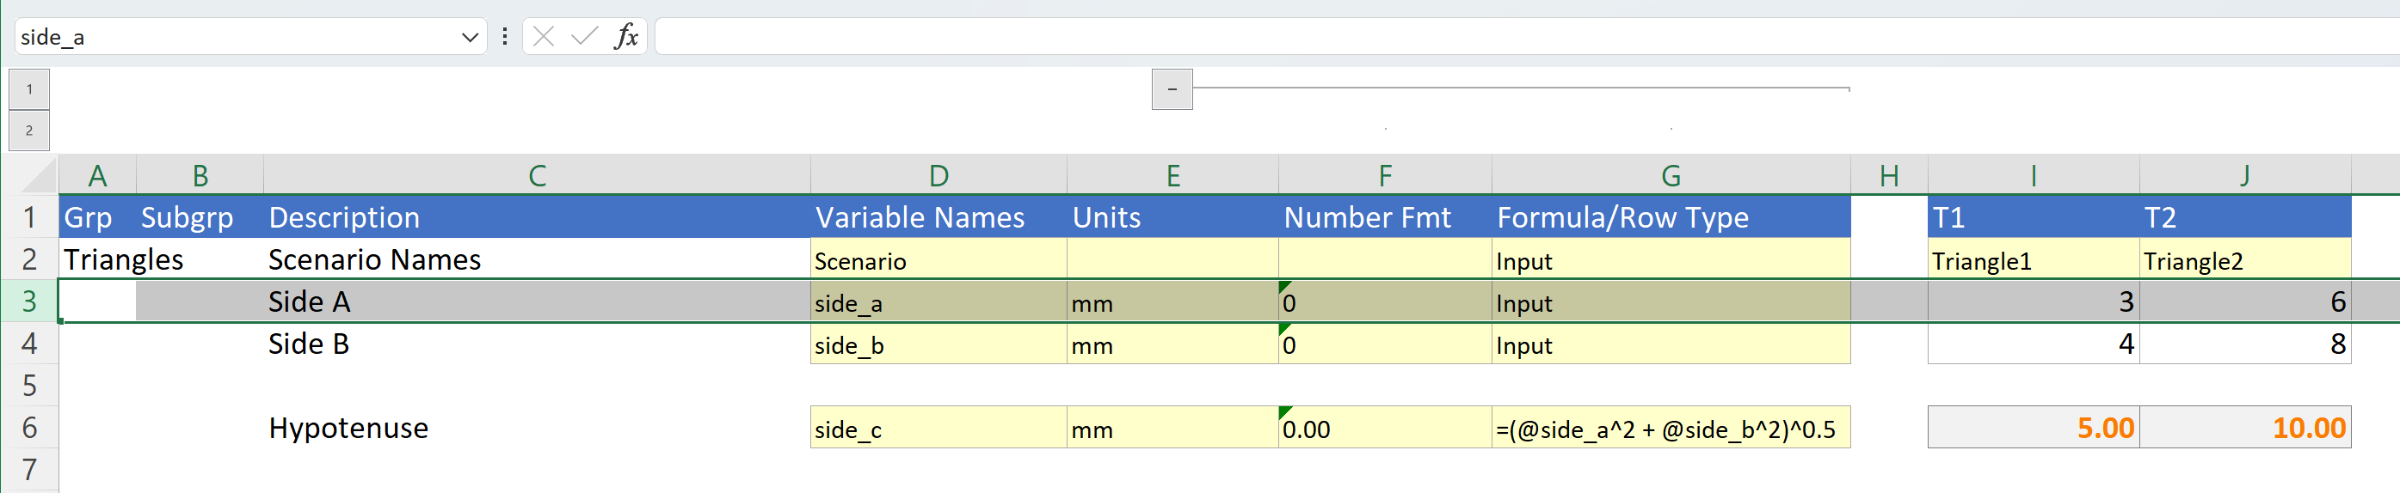
Named range for Row 3
Scenario (column) names
Row formula for side_c
Calculated values

Slide 2
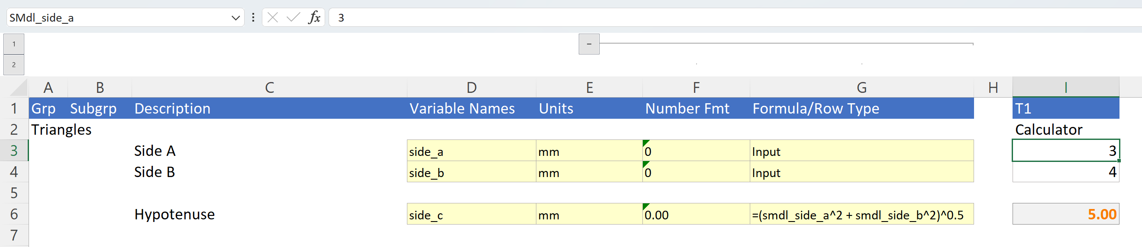
Named range for Cell $I$3 (with optional sheet name prefix)
Cell formula for side_c
Calculated value

Slide 3
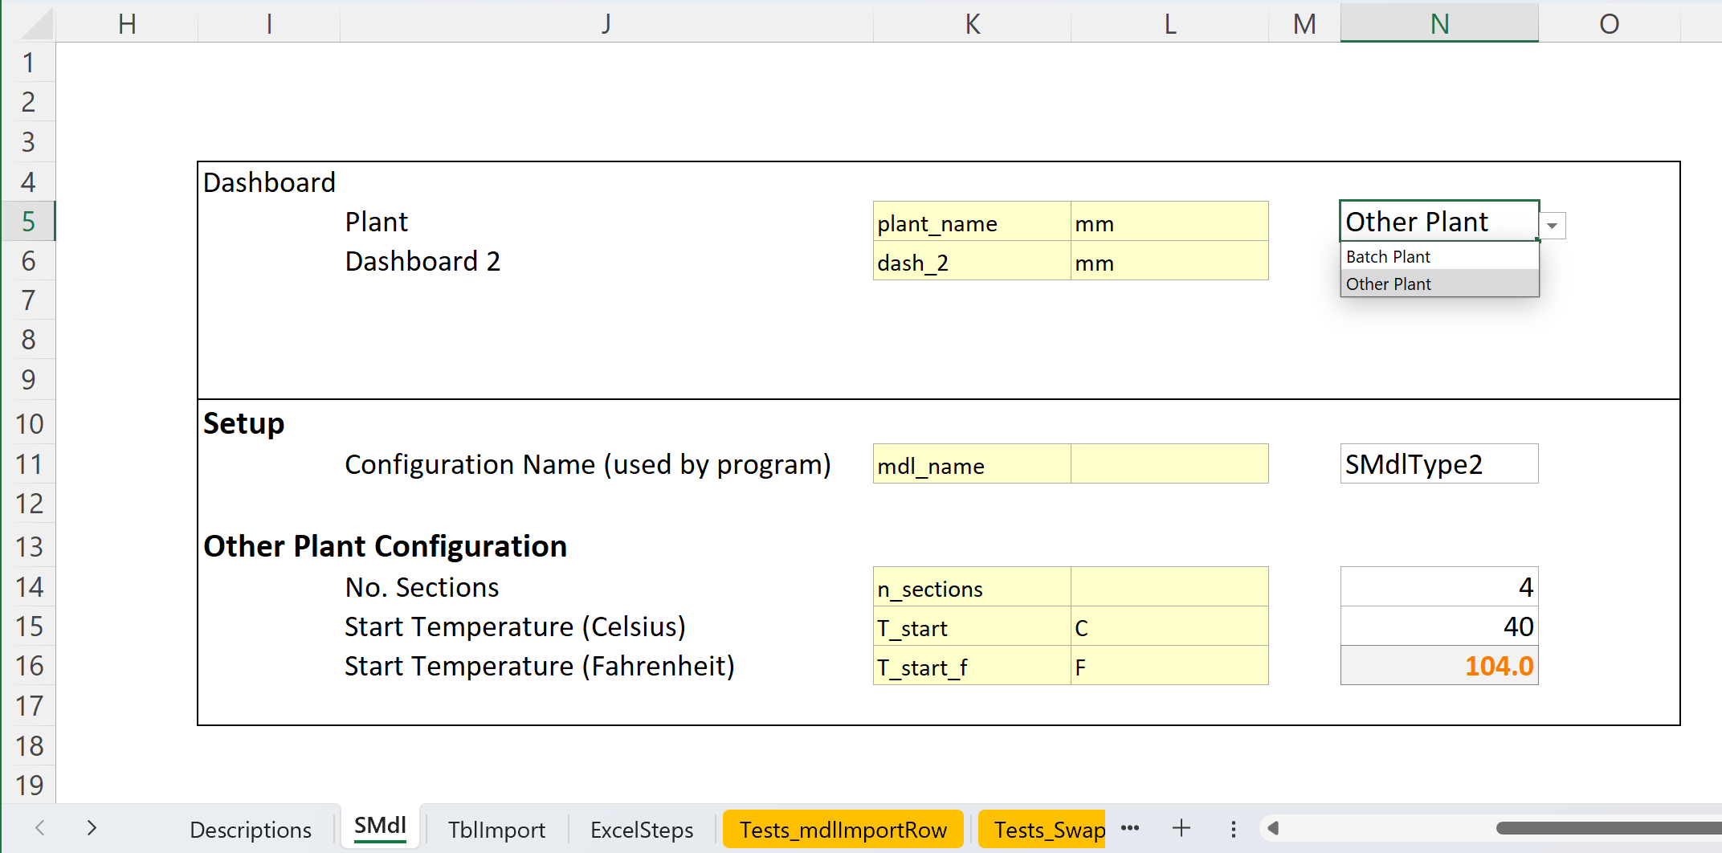
Stationary “Dashboard” Scenario Model (not affected by Swap)
Model Selector Cell. Changes Trigger Swap
Swappable Scenario Model (from TblImport sheet)

Slide 4
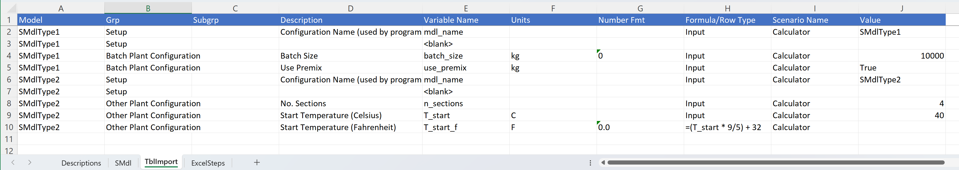
Required mdl_name wayfinding parameter
Example calculated variable

